Slide 1
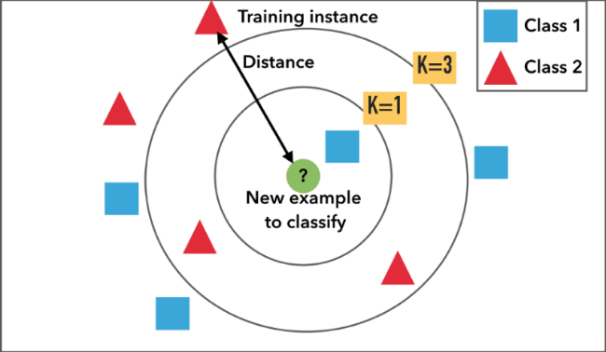
Instance Based Learning K-Nearest Neighbor
8
- Dr. Sifat Momen (SfM1)

Slide 2
Learning goals
After this presentation, you should be able to
Understand how KNN can be used to make prediction
Understand the strengths and weaknesses of KNN

Slide 3
Jupyter Notebook
Please note that there is an associated Jupyter notebook with this presentation
Please use both in parallel for optimal understanding

Slide 4

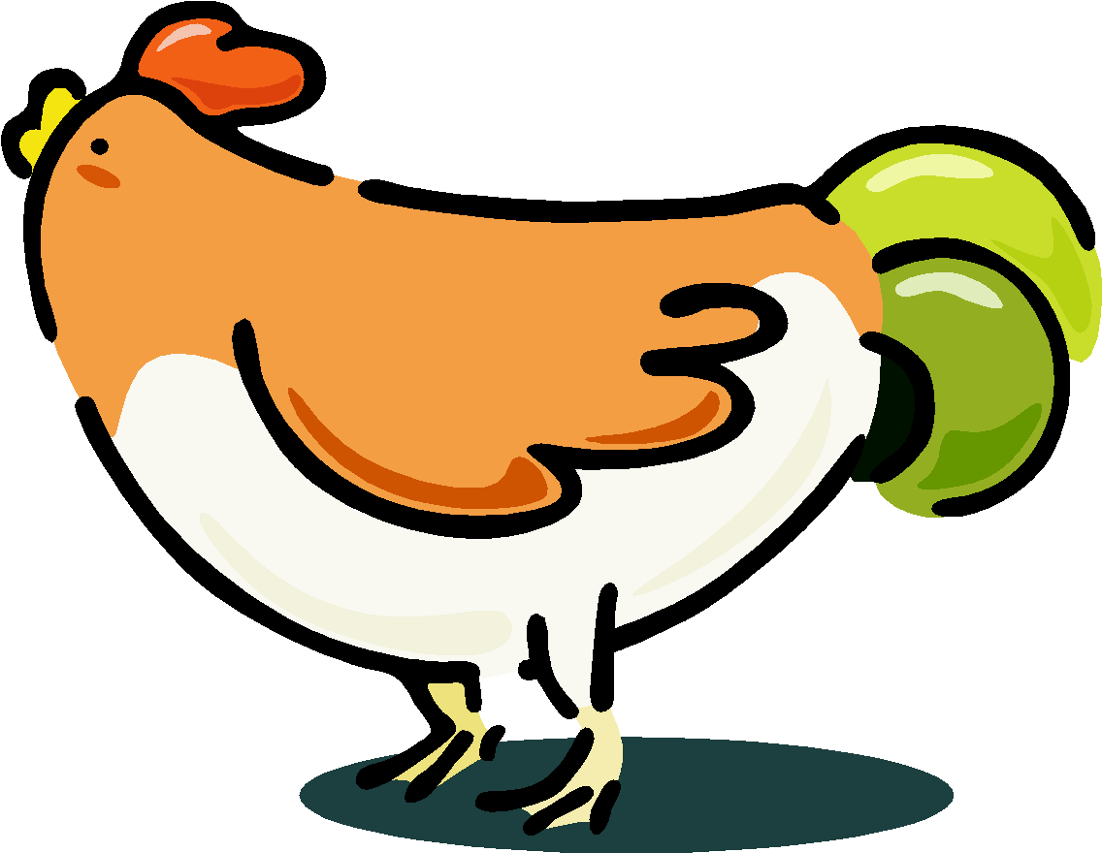


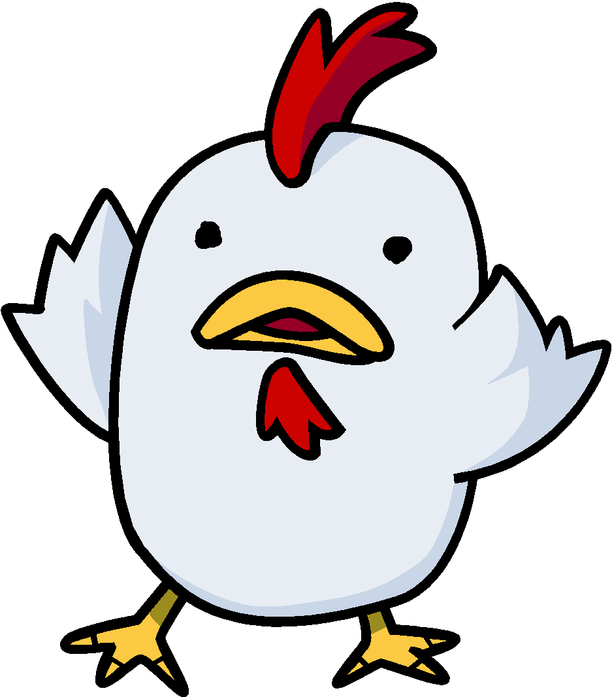

Nearest Neighbor Classifiers
Basic idea:
If it walks like a duck, looks like a duck, quacks like a duck, then it’s probably a duck
Compute Distance
Test Record
Training Records
Choose k of the “nearest” records

Slide 5
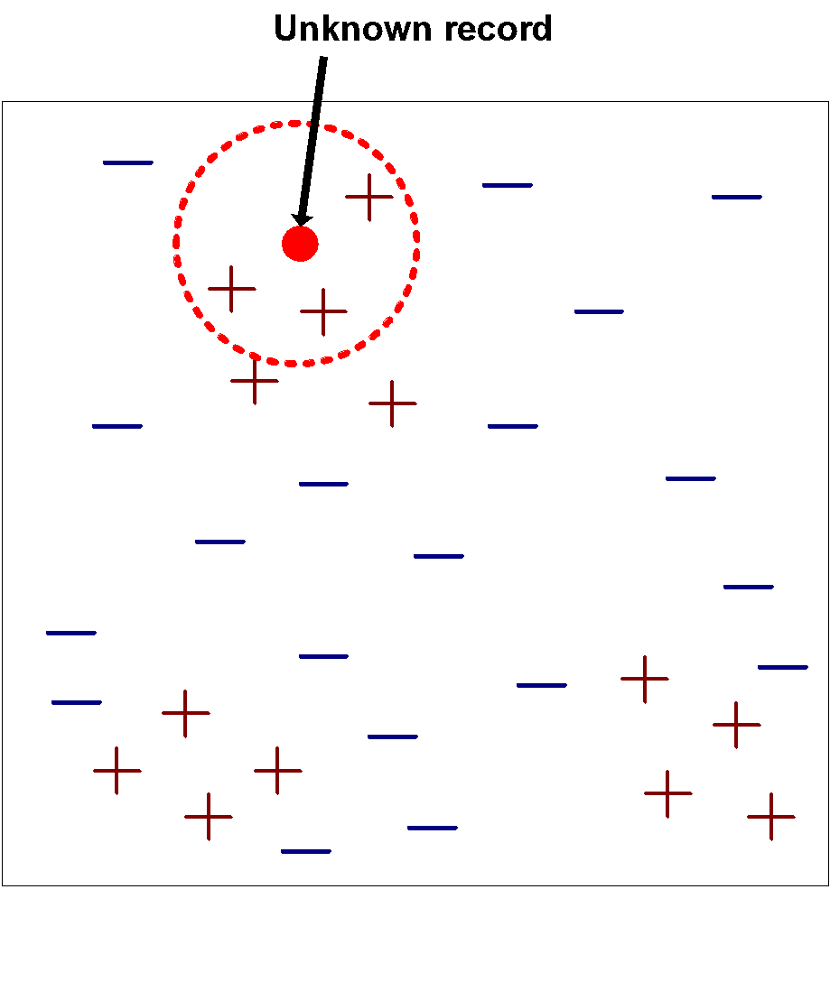
Nearest-Neighbor Classifiers
Requires the following:
A set of labeled records
Proximity metric to compute distance/similarity between a pair of records
e.g., Euclidean distance
The value of k, the number of nearest neighbors to retrieve
A method for using class labels of K nearest neighbors to determine the class label of unknown record (e.g., by taking majority vote)

Slide 6
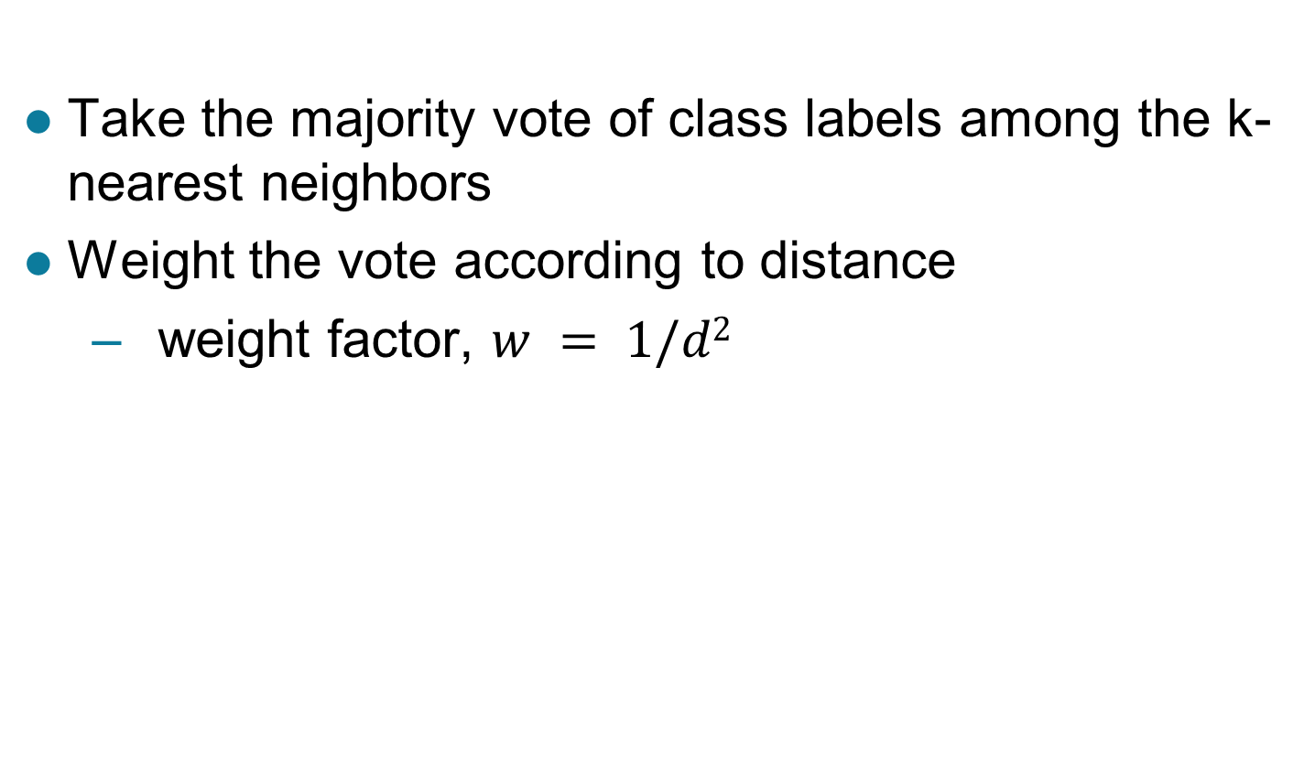
How to Determine the class label of a Test Sample?

Slide 7
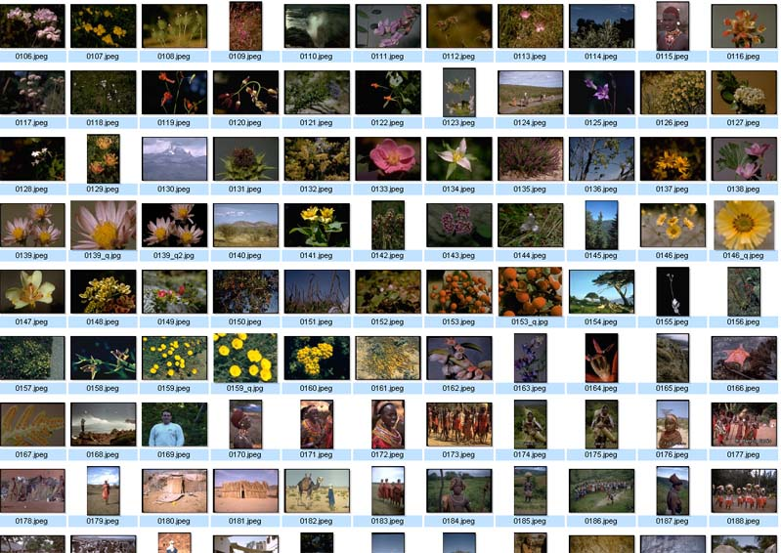
Nearest Neighbor Query in High Dimensions
Very important and practical problem!
Image retrieval
find N closest
matches (i.e., N
nearest neighbors)
(f₁,f₂, .., f_{k})

Slide 8
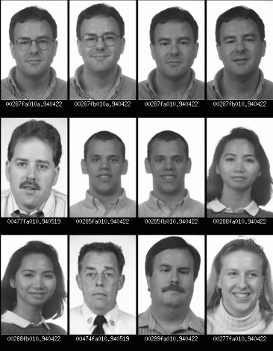
Nearest Neighbor Query in High Dimensions
Face recognition
find closest match
(i.e., nearest neighbor)

Slide 9
Nearest Neighbor Classification…
Data preprocessing is often required
Attributes may have to be scaled to prevent distance measures from being dominated by one of the attributes
Example:
height of a person may vary from 1.5m to 1.8m
weight of a person may vary from 90lb to 300lb
income of a person may vary from $10K to $1M
Time series are often standardized to have 0 means a standard deviation of 1

Slide 10
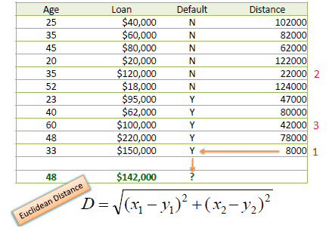

Slide 11
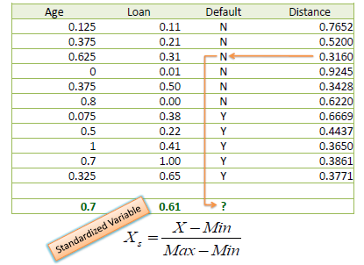
Need for Standardizing Attributes

Slide 12
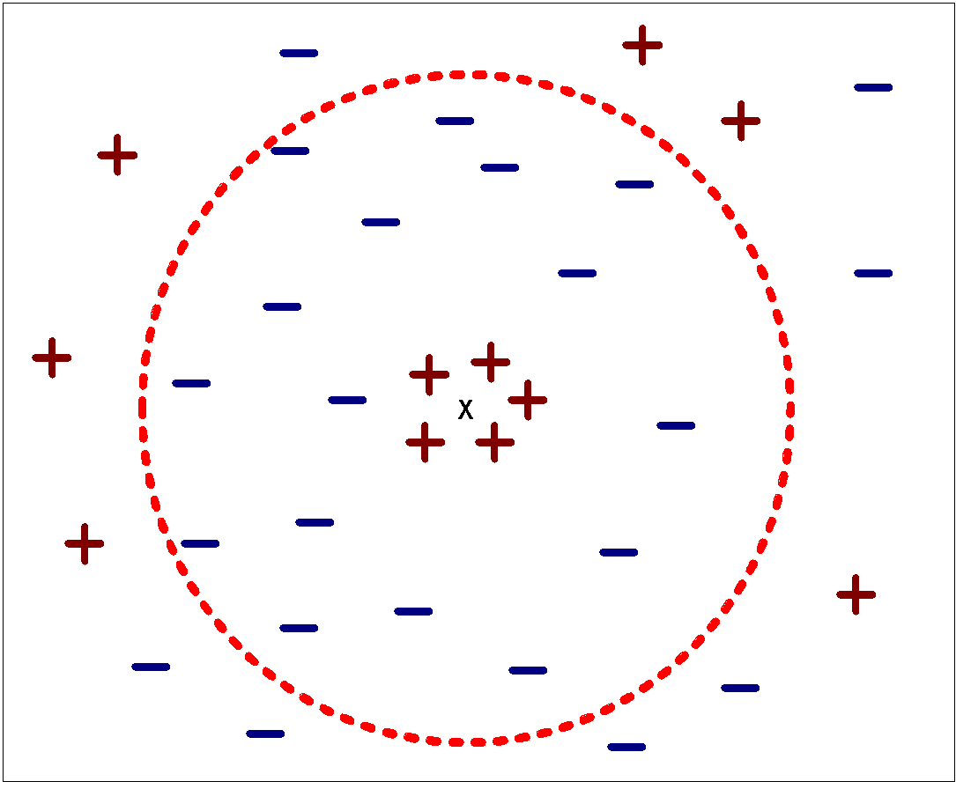
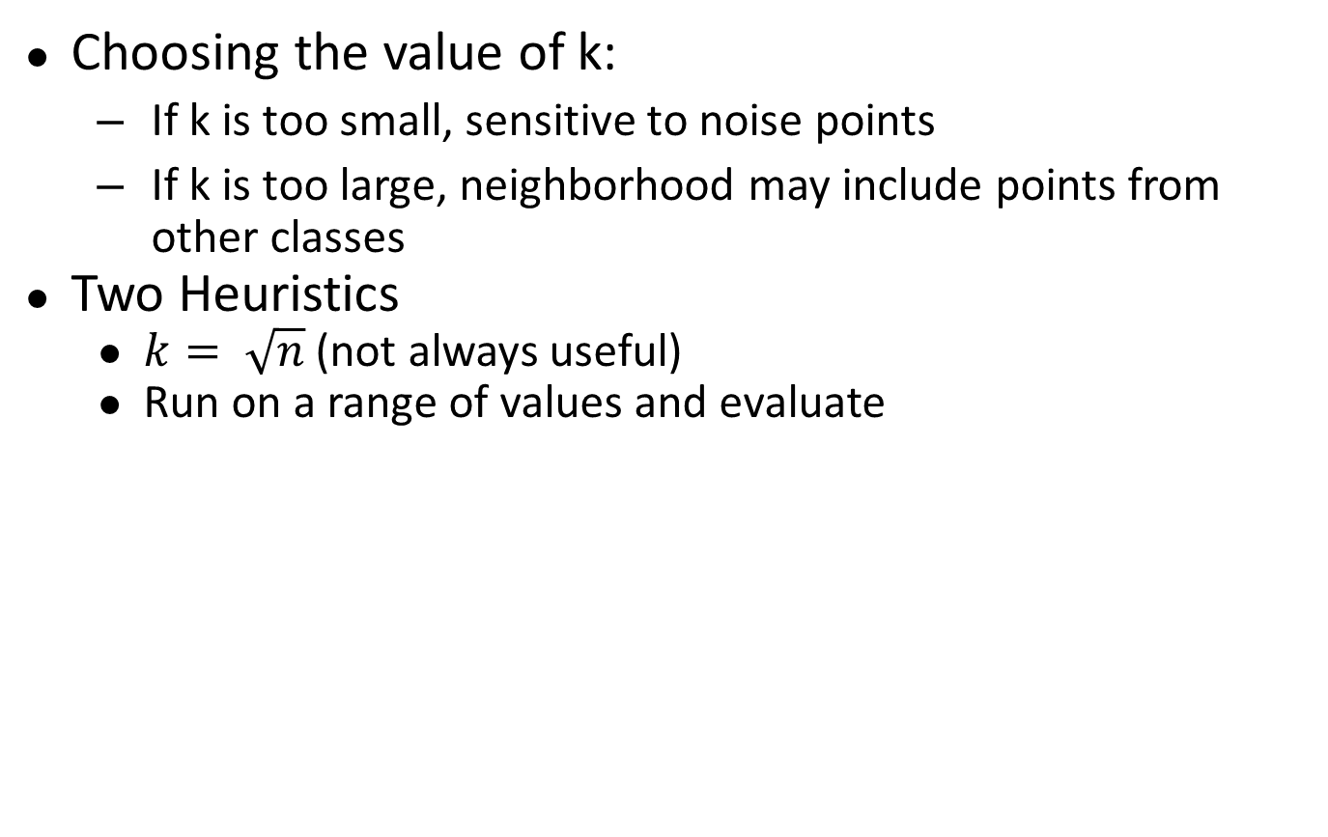
Nearest Neighbor Classification…
Choosing the value of k:
If k is too small, sensitive to noise points
If k is too large, neighborhood may include points from other classes
Two Heuristics
$k= \sqrt{n}$ (not always useful)
Run on a range of values and evaluate

Slide 13
Improving KNN Efficiency
Lazy Classifier
Avoid having to compute distance to all objects in the training set
Multi-dimensional access methods (k-d trees)
Fast approximate similarity search
Locality Sensitive Hashing (LSH)
Condensing
Determine a smaller set of objects that give the same performance
Editing
Remove objects to improve efficiency

Slide 14
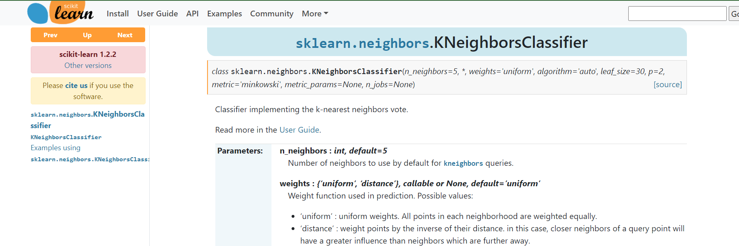

Slide 15
